Slide 1
Pay Slip Generation Utility
Created By: RPA Group 3 Batch 14
Members: Neha Natesh, Najma Fathima, Shradha Sarap
Mentor / Guide: Preethi, Sumathi
Date: 22nd March 2022

Slide 2
Agenda
Introduction/ Team Members and their Roles
Goal
Current As-is Process
To-Be Process
Value Added Benefits of the Automation Process
Walkthrough of the Automation
Q/A session

Slide 3



Introduction / Team Members and their roles
Introduction:
Live project done by Group 3 batch 14 of Go Easy RPA course.
Project aim was to create an end to end automated process starting from an input sheet of employee data to sending customised pay slips to individual employees
Team members and Roles
Shradha Sarap - Input data Processing, Input error handling Process, PPT, PDD and Testing
Neha Natesh - Generating the pay slips from Word to pdf Process, compilation of all the workflows, error handling, Testing, PPT, and PDD
Najma Fathima - Sending the Pay slips process to each employee, error handling, PDD, PPT and Testing

Slide 4

GOAL- Reclaim Your HR Professional’s time
Payslip generation and processing is one of the most essential and yet most cumbersome functions of the HR Department.
The Main Goal of our Payslip Automation Process is to relieve the HR professional from his/her repetitive, time consuming and redundant tasks , so that they can focus on strategic initiatives of the company.
Research study states that RPA reclaims 40% of the HR departments time, making them more human centric and maintaining work balance.
100% accuracy rate, reduced processing time/resources and creating an happy environment for the HR professionals.

Slide 5

Current AS-IS Process
The HR professional checks the employee’s salary details from the employee salary excel sheet.
He/she then enters all the required data into the Payslip word template.
He/she then converts it to pdf format.
If there is any issue any employee entry in salary excel sheet, logs error messages along each entry and sends it to department person for recheck and revert.
All error free payslips are sent to individual employees using email ID from the excel sheet
This process has to be repeated for “X” number of employees of the company
Each Employee Payslip generation takes time (approx -10-15minutes)

Slide 6
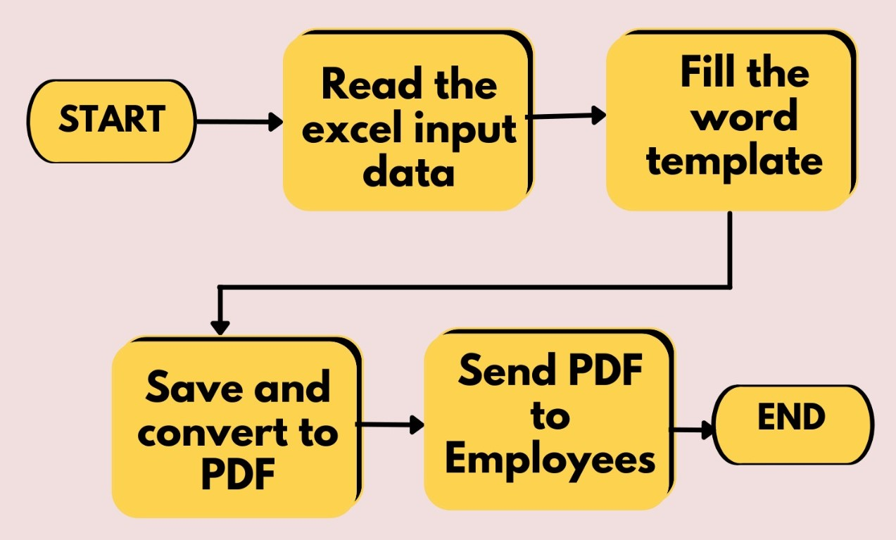
To-Be Process
Overview
The automated Pay slip generation utility uses a robot to do all the activities required for processing, generation and sending of pay slips to employees
The input data required by the robot is the input excel sheet and config file(containing the guarded information). The email logon details and config file path are available as assets in orchestrator
Report of successful and unsuccessful process for each employee is sent to HR personnel via an email
The process ensures errorfree and timely execution of the payroll activity

Slide 7
Value added Benefits of the Automation
Pay Slip Processing - Manual | Pay Slip Processing - Automated
The entire process has to be handled and managed by individuals | Automated process is managed by the computerised system with robot and requires minimal human effort
The process is lengthy, cumbersome. Requires lots of manual resources and time. Approx- 10-15min /employee | The process is faster , just on a click. It ensures timely completion of the job(Our process takes 2.30 min for 10 employees)
This system can have inconsistencies due to dynamic nature of human activities | Automated system, so no room for inconsistency and fatigue
Scope of errors can be large | Scope of error is marginal in beginning and robust over a period of time
System is less secure . Misuse of data can happen | Data is encrypted and hence secure
As the number of employees increase, timely processing cannot be ensured with same resources | Can be scaled up easily and timely delivery is not hampered
This system is time consuming, and is prone to errors which may cause dissatisfaction of employees | Automated systems are reliable, quick and accurate. This leads to high level of customer satisfaction
System dependability on Public holidays and working hours | Automated system is independent of holidays and working hours once scheduled

Slide 8
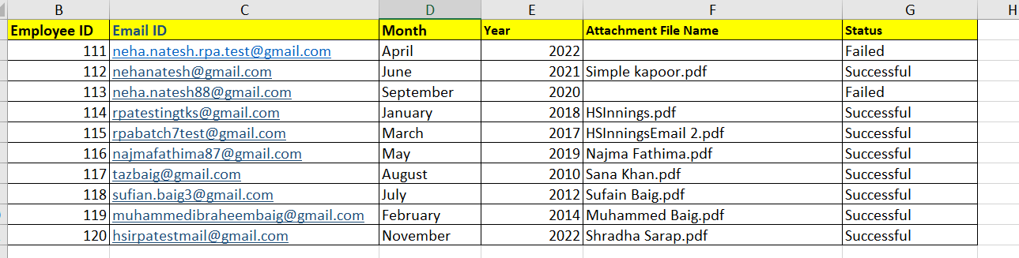
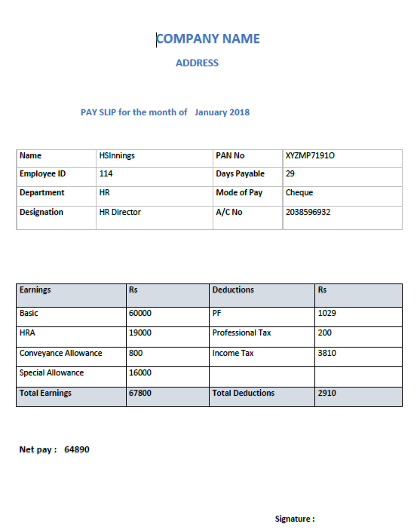
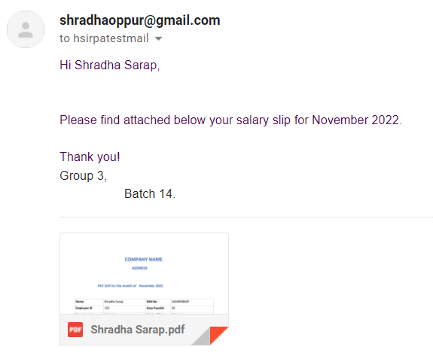
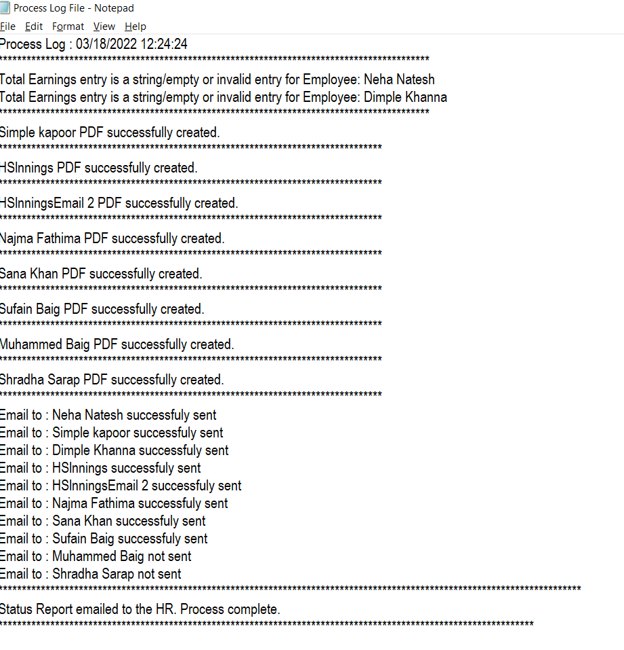
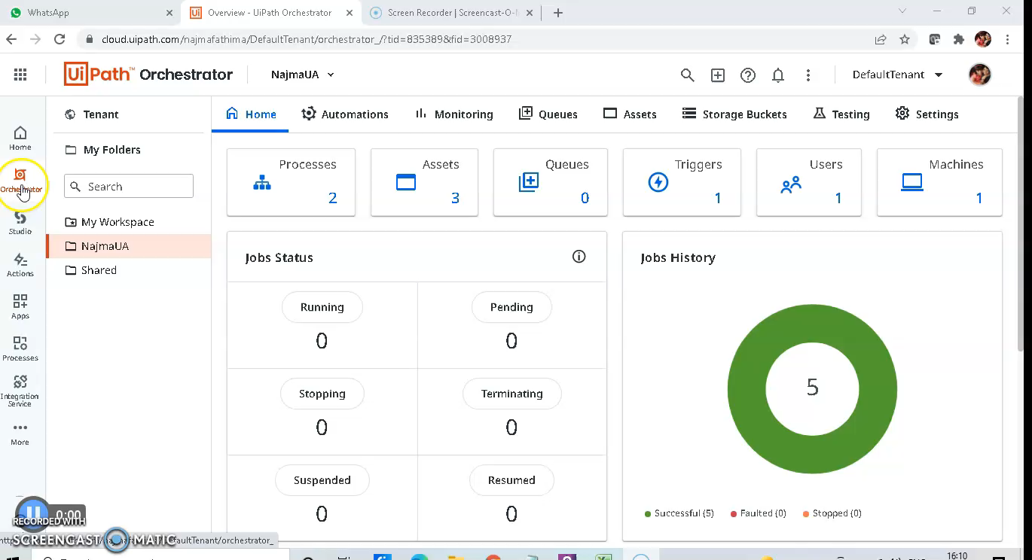
Walkthrough of the Automation
Input excel employee data file
Output Payslip in pdf format/Email/status and log file
Process Video Run

Slide 9

Q/A session Thank You for your time Happy Automation!!!!

